Slide 1
Omlette
Pptshki.ru

Slide 2
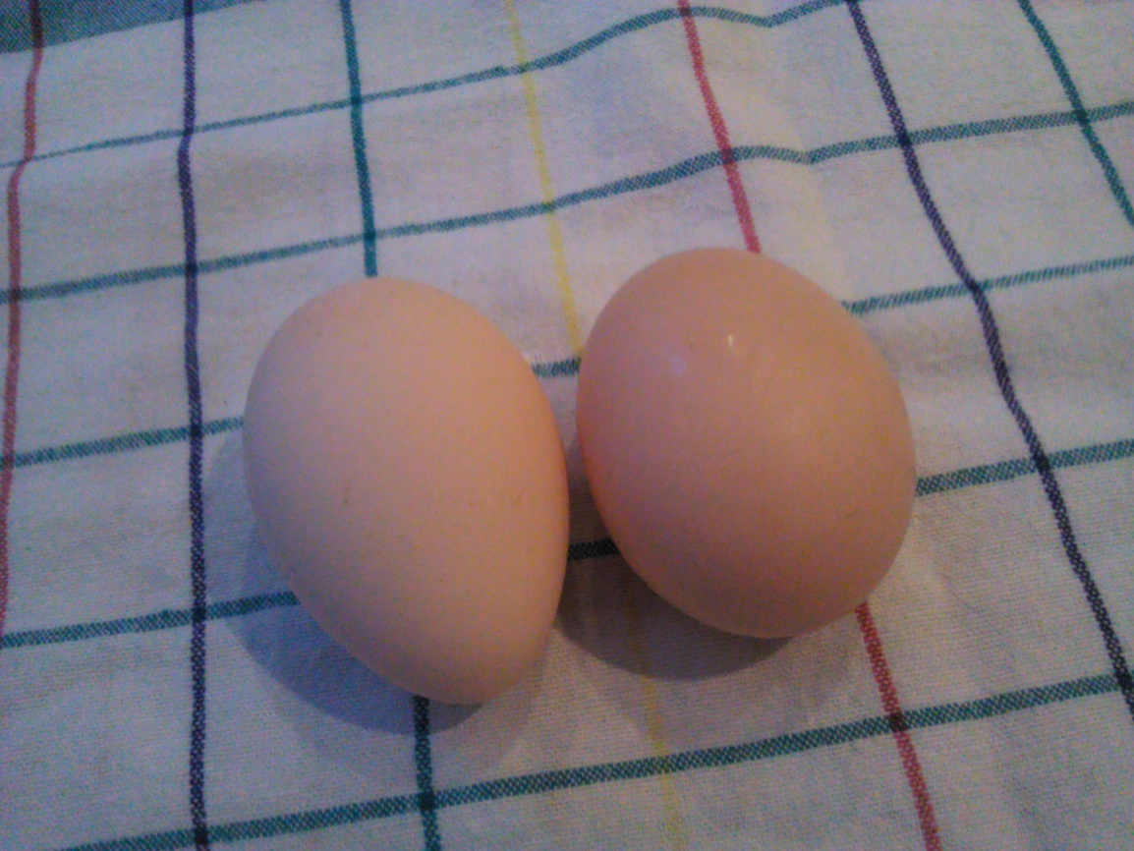
.
We need:
.
1. two eggs

Slide 3
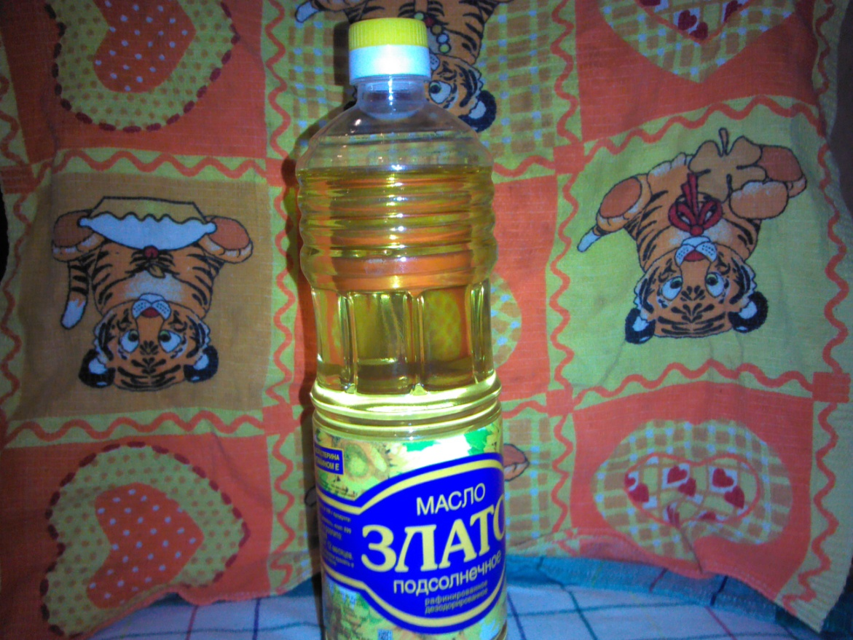
.
.
Sunflower butter

Slide 4
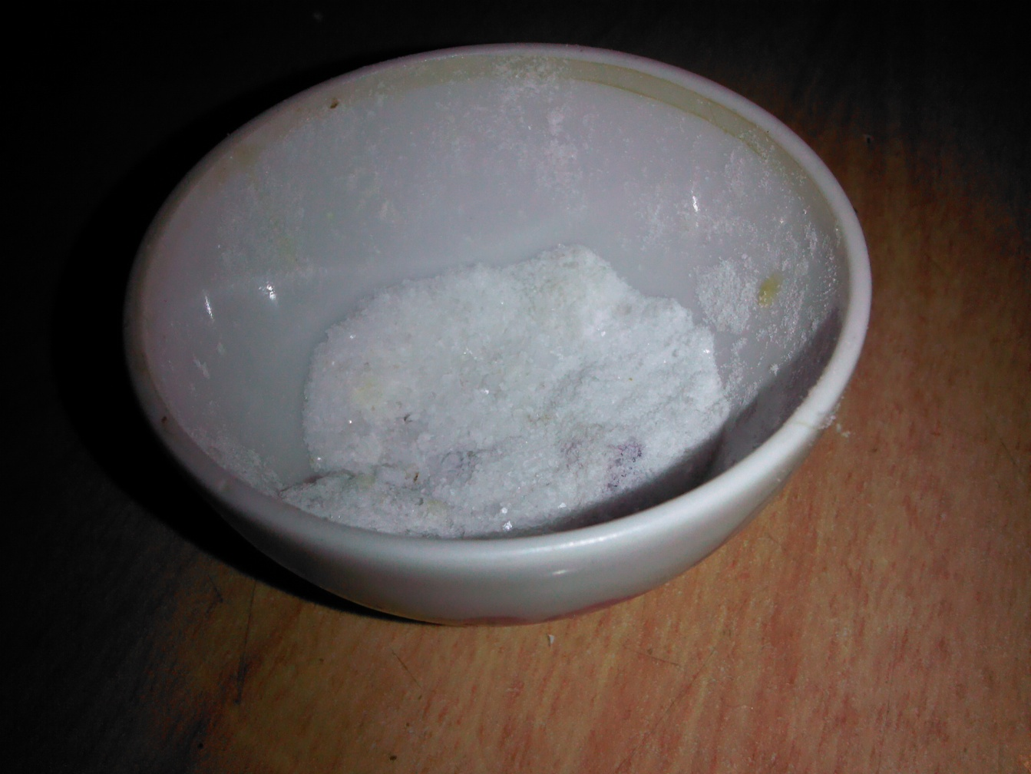
Salt

Slide 5
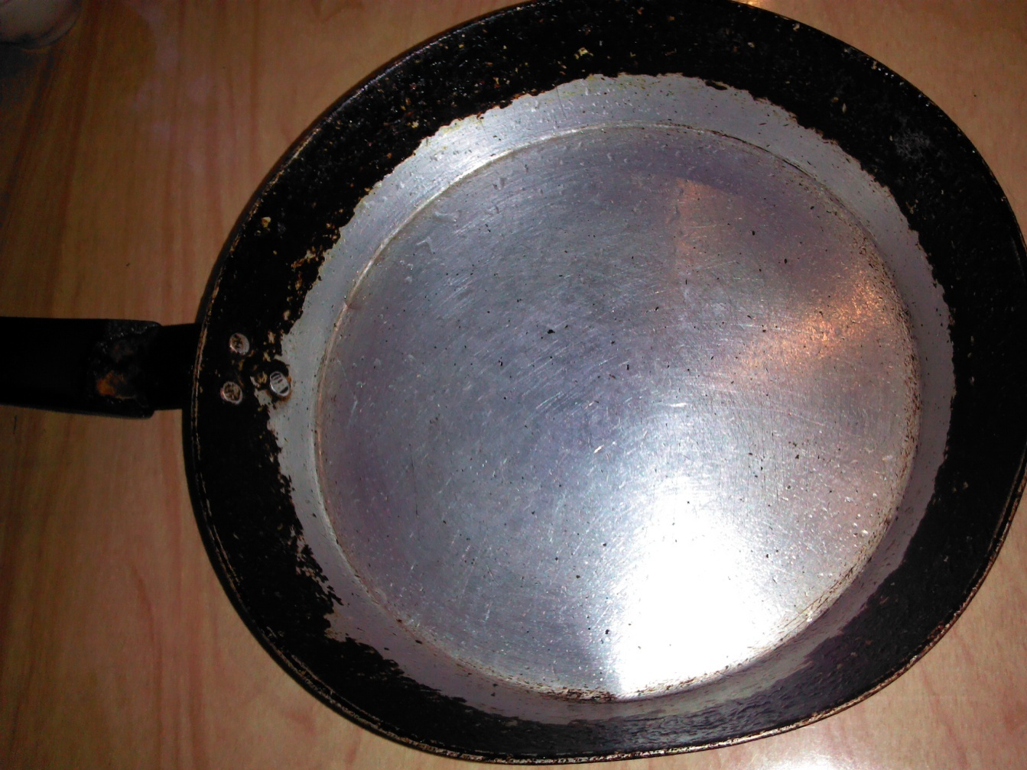
Pan

Slide 6
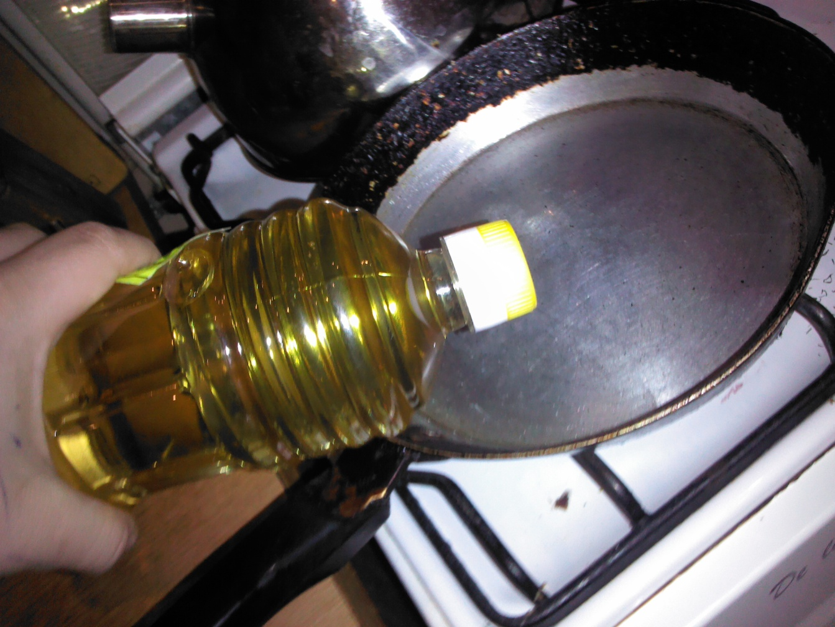
Pour the sunflower butter in a frying pan

Slide 7
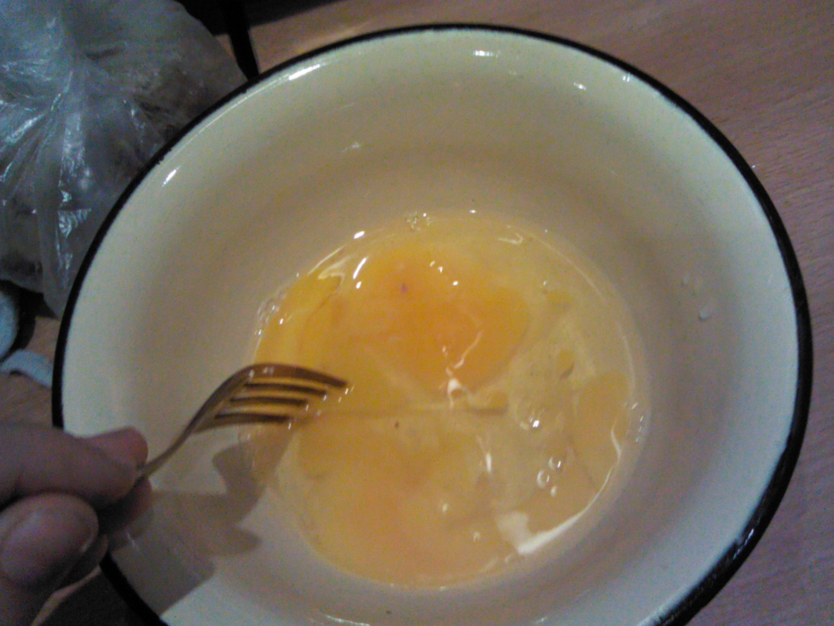
Mix eggs

Slide 8
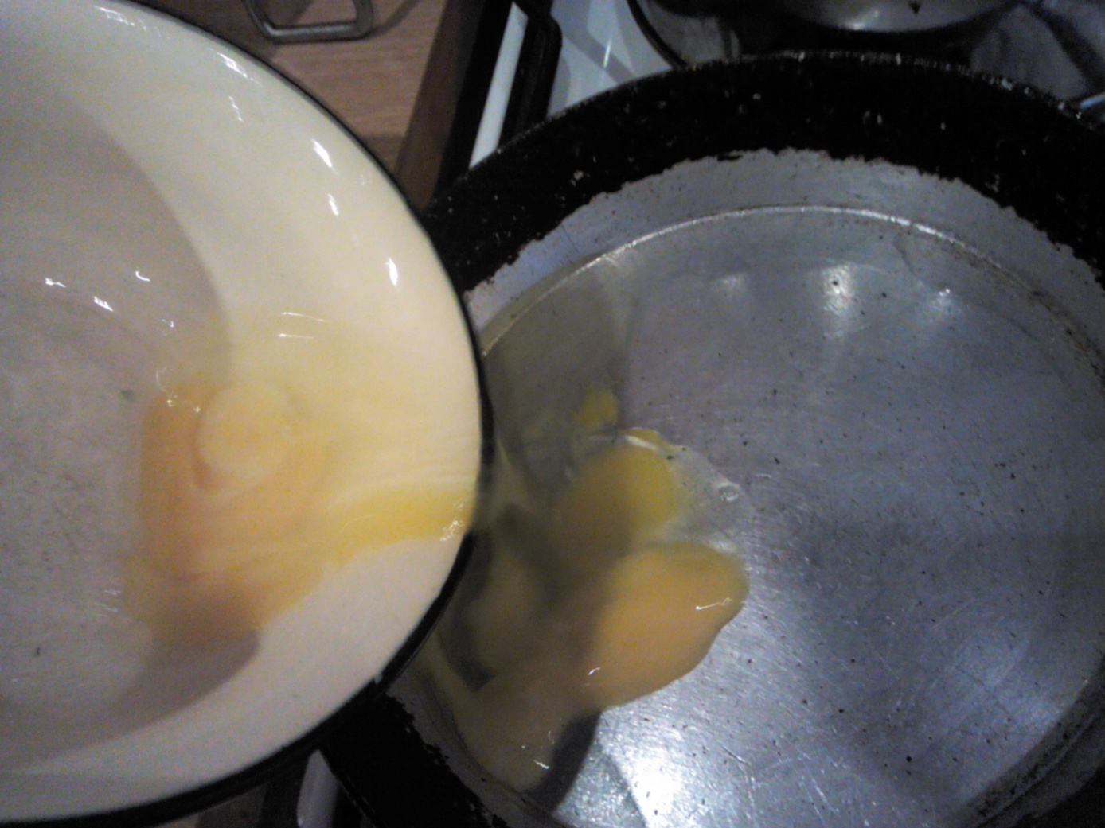
Pour the eggs into the pan

Slide 9
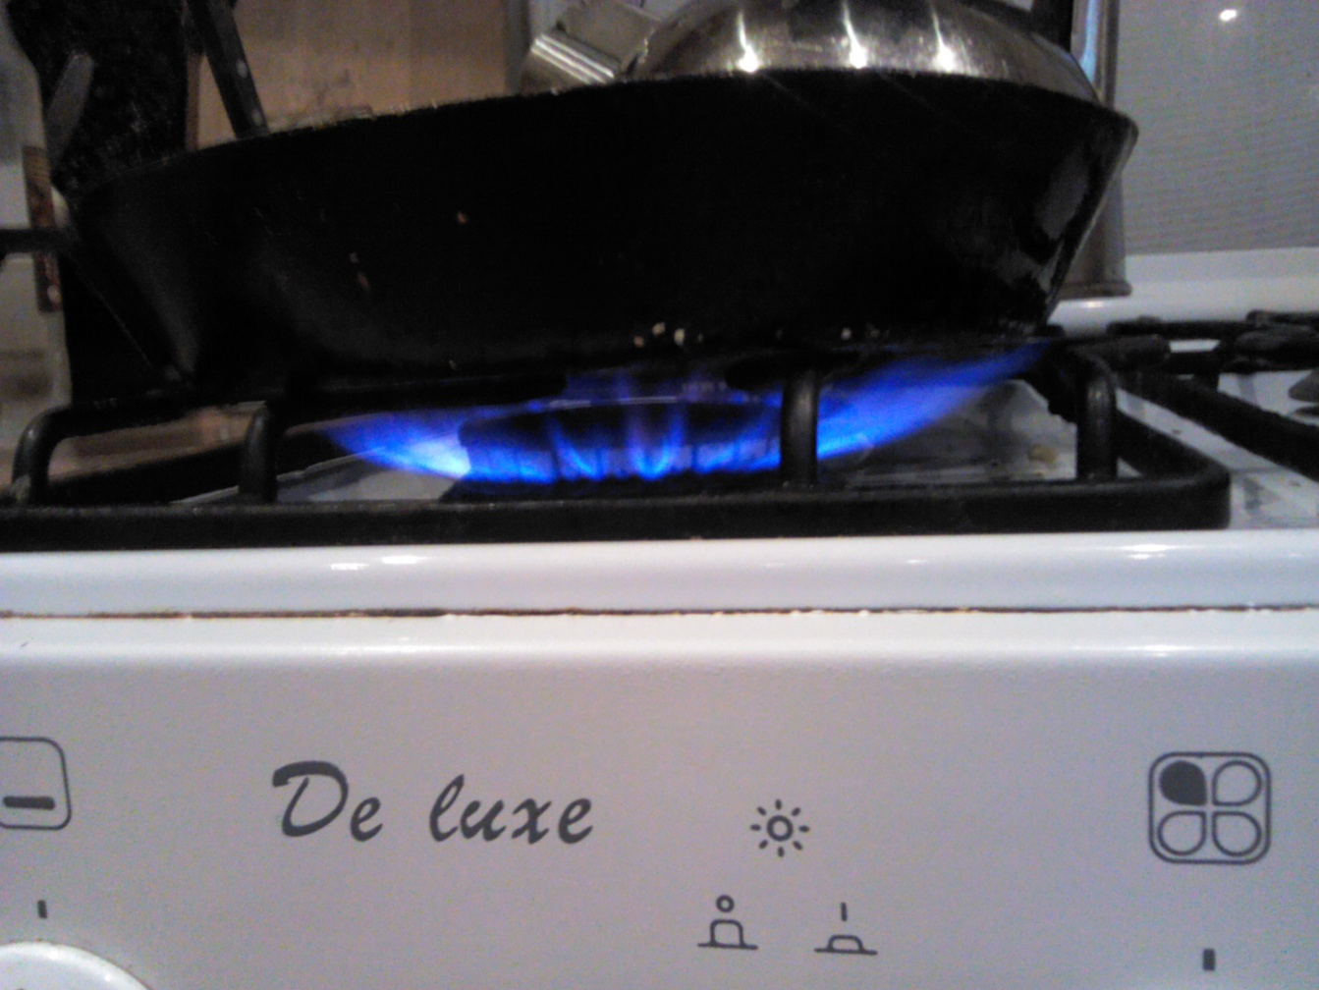
Include a fire

Slide 10
Add salt

Slide 11
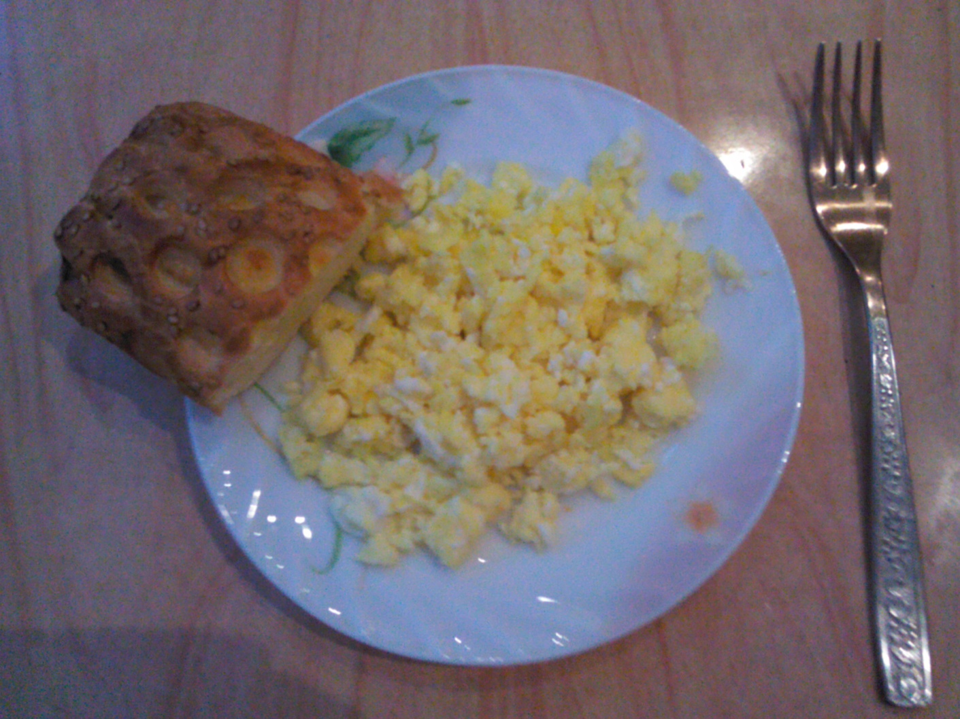
Omelet ready!

